Slide 1
Computer Graphics
UNIT 2
Graphics Output Primitives
Dr. Pallavi Pratap

Slide 2
Circle Generating Algorithms
Circles and ellipses are common components in many pictures.
Circle generation routines are often included in packages.

Slide 3
Circle Equations
Polar form
  x = rCosθ
  y = rSinθ (r = radius of circle)
y
P=(rCosθ, rSinθ)
r
rSinθ)
θ
x
rCosθ)

Slide 4
Drawing a circle
θ = 0°
while (θ < 360°)
  x = rCosθ
  y = rSinθ
  setPixel(x,y)
  θ = θ + 1°
end while
Disadvantages
To find a complete circle θ varies from 0° to 360°
The calculation of trigonometric functions is very slow.

Slide 5
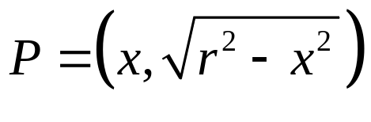
Cartesian form
Use Pythagoras theorem
  x² + y² = r²
r
y
x
y
r
y
x
x

Slide 6
Circle algorithms
Step through x-axis to determine y-values
Disadvantages:
  Not all pixel filled in
  Square root function is very slow

Slide 7
Circle Algorithms
Use 8-fold symmetry and only compute pixel positions for the 45° sector.
(-x, y)
(x, y)
(-y, x)
45°
(y, x)
(-y, -x)
(y, -x)
(-x, -y)
(x, -y)

Slide 8
Midpoint Circle Algorithm
y_{i} | ■
y_{i}-1
 | x_{i} | x_{i}+1 | x_{i}+2
Midpoint
x² + y² – r² = 0
Assuming that we have just plotted the pixels at (x_{i} , y_{i}).
Which is next? (x_{i}+1, y_{i}) OR (x_{i}+1, y_{i} – 1).
- The one that is closer to the circle.

Slide 9
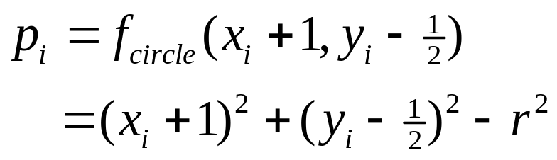
Midpoint Circle Algorithm
The decision parameter is the circle at the midpoint between the pixels y_{i} and y_{i} – 1.
If p_{i} < 0, the midpoint is inside the circle and the pixel y_{i} is closer to the circle boundary.
If p_{i} ≥ 0, the midpoint is outside the circle and the pixel y_{i} - 1 is closer to the circle boundary.

Slide 10
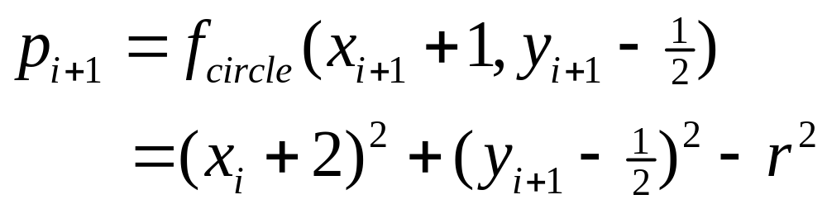
Decision Parameters
Decision Parameters are obtained using incremental calculations
    OR
    where y_{i+1} is either y_{i} or y_{i}-1 depending on the sign of p_{i}
Note:
x_{i+1} = x_{i} +1

Slide 11
The Algorithm
Initial values:- point(0,r)
    x₀ = 0
    y₀ = r
Initial decision parameter
At each x_{i} position, starting at i = 0, perform the following test: if p_{i} < 0, the next point is (x_{i} + 1, y_{i}) and
    p_{i+1} = p_{i} + 2x_{i+1} + 1
  If p_{i} ≥ 0, the next point is (x_{i}+1, y_{i}-1) and
    p_{i+1} = p_{i} + 2x_{i+1} + 1 – 2y_{i+1}
  where 2x_{i+1} = 2x_{i} + 2 and 2y_{i+1} = 2y_{i} – 2
Determine symmetry points in the other octants
Move pixel positions (x,y) onto the circular path centered on (x_{c}, y_{c}) and plot the coordinates: x = x + x_{c}, y = y + y_{c}
Repeat 3 – 5 until x ≥ y
move circle origin at (0,0) by
x = x – x_{c} and y = y – y_{c}

Slide 12
Example
r = 10
p₀ = 1 – r = -9 (if r is integer round p₀ = 5/4 – r to integer)
Initial point (x₀, y₀) = (0, 10)
10 | ■ | ■ | ■ | ■
9 |  |  |  |  | ■ | ■
8 |  |  |  |  |  |  | ■
7 |  |  |  |  |  |  |  | ■
6 |  |  |  |  |  |  |  |  | ■
5 |  |  |  |  |  |  |  |  |  | ■
4 |  |  |  |  |  |  |  |  |  | ■
3 |  |  |  |  |  |  |  |  |  |  | ■
2 |  |  |  |  |  |  |  |  |  |  | ■
1 |  |  |  |  |  |  |  |  |  |  | ■
0 |  |  |  |  |  |  |  |  |  |  | ■
 | 0 | 1 | 2 | 3 | 4 | 5 | 6 | 7 | 8 | 9 | 10
i | p_{i} | x_{i+1}, y_{i+1} | 2x_{i+1} | 2y_{i+1}
0 | -9 | (1, 10) | 2 | 20
1 | -6 | (2, 10) | 4 | 20
2 | -1 | (3, 10) | 6 | 20
3 | 6 | (4, 9) | 8 | 18
4 | -3 | (5, 9) | 10 | 18
5 | 8 | (6, 8) | 12 | 16
6 | 5 | (7, 7)

Slide 13
Exercises
Draw the circle with r = 12 using the Midpoint-circle algorithm
Draw the circle with r = 14 and center at (15, 10).

Slide 14
Exercises
Prove that if p_{i} < 0 and y_{i+1} = y_{i} then
p_{i+1} = p_{i} + 2x_{i+1} + 1
Prove that if p_{i} ≥ 0 and y_{i+1} = y_{i}-1 then
p_{i+1} = p_{i} + 2x_{i+1} + 1 – 2y_{i+1}

Slide 15
Midpoint function
void plotpoints(int x, int y)
{
setpixel(xcenter+x, ycenter+y);
setpixel(xcenter-x, ycenter+y);
setpixel(xcenter+x, ycenter-y);
setpixel(xcenter-x, ycenter-y);
setpixel(xcenter+y, ycenter+x);
setpixel(xcenter-y, ycenter+x);
setpixel(xcenter+y, ycenter-x);
setpixel(xcenter-y, ycenter-x);
}
void circle(int r)
{
int x = 0, y = r;
plotpoints(x,y);
int p = 1 – r;
while (x<y) {
x++;
if (p<0) p += 2*x + 1;
else {
y--;
p += 2*(x-y) + 1;
}
plotpoints(x,y);
}
}

Slide 16
Ellipse-Generating Algorithms
Ellipse – A modified circle whose radius varies from a maximum value in one direction (major axis) to a minimum value in the perpendicular direction (minor axis).
d₁
F₁
P=(x,y)
d₂
F₂
The sum of the two distances d₁ and d₂, between the fixed positions F₁ and F₂ (called the foci of the ellipse) to any point P on the ellipse, is the same value, i.e.
d₁ + d₂ = constant

Slide 17
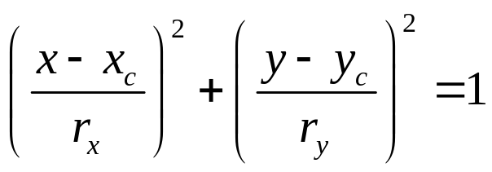
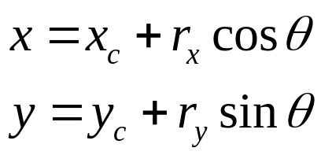
Ellipse Properties
Expressing distances d₁ and d₂ in terms of the focal coordinates F₁ = (x₁, x₂) and F₂ = (x₂, y₂), we have:
Cartesian coordinates:
Polar coordinates:
r_{y}
r_{x}

Slide 18
Ellipse Algorithms
Symmetry between quadrants
Not symmetric between the two octants of a quadrant
Thus, we must calculate pixel positions along the elliptical arc through one quadrant and then we obtain positions in the remaining 3 quadrants by symmetry
(-x, y)
(x, y)
r_{y}
r_{x}
(-x, -y)
(x, -y)

Slide 19
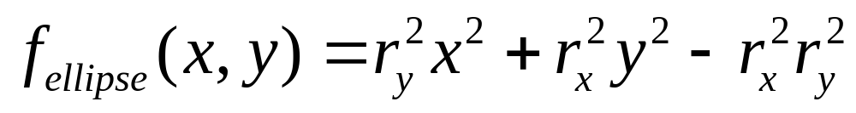
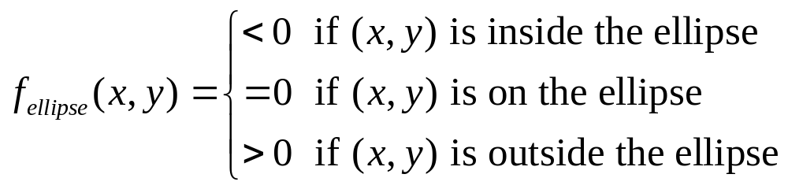
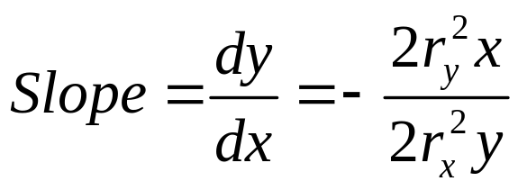
Ellipse Algorithms
Decision parameter:
Slope = -1
1
r_{y}
2
r_{x}

Slide 20
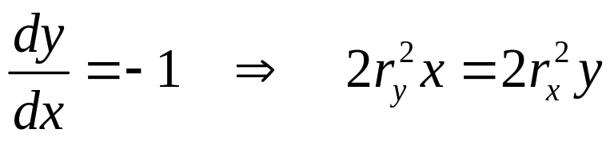
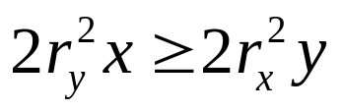
Ellipse Algorithms
Slope = -1
1
r_{y}
2
r_{x}
Starting at (0, r_{y}) we take unit steps in the x direction until we reach the boundary between region 1 and region 2. Then we take unit steps in the y direction over the remainder of the curve in the first quadrant.
At the boundary
therefore, we move out of region 1 whenever

Slide 21
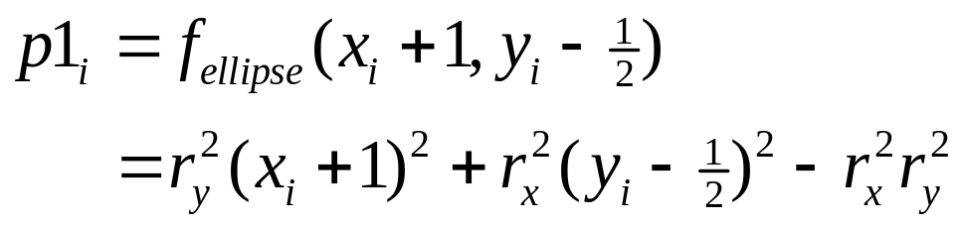
Midpoint Ellipse Algorithm
y_{i} | ■
y_{i}-1
 | x_{i} | x_{i}+1 | x_{i}+2
Midpoint
Assuming that we have just plotted the pixels at (x_{i} , y_{i}).
The next position is determined by:
If p1_{i} < 0 the midpoint is inside the ellipse ⇒ y_{i} is closer
If p1i ≥ 0 the midpoint is outside the ellipse ⇒ y_{i} – 1 is closer

Slide 22
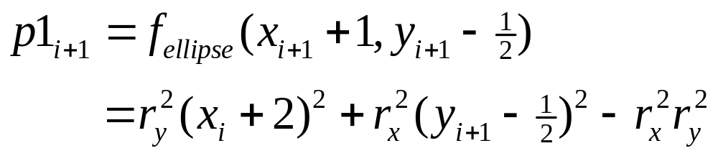
Decision Parameter (Region 1)
At the next position [x_{i+1} + 1 = x_{i} + 2]
OR
where y_{i+1} = y_{i}
or y_{i+1} = y_{i} – 1

Slide 23
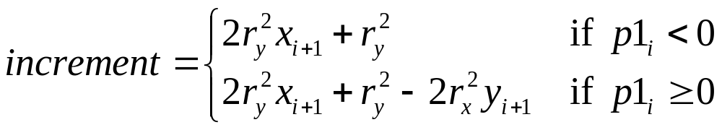
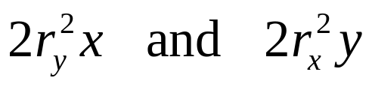
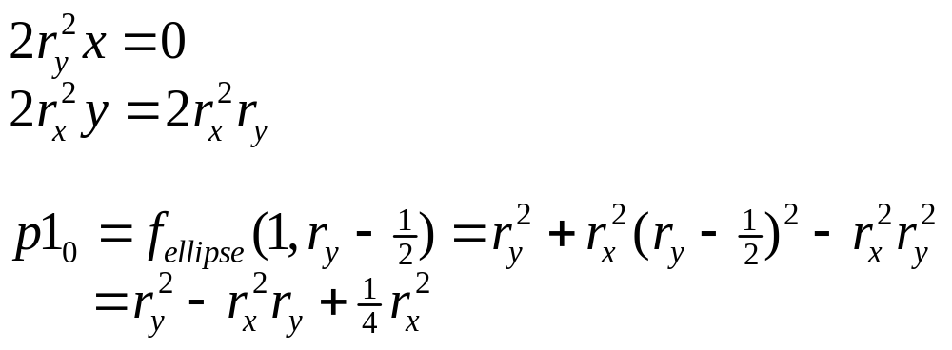
Decision Parameter (Region 1)
Decision parameters are incremented by:
Use only addition and subtraction by obtaining
At initial position (0, r_{y})

Slide 24
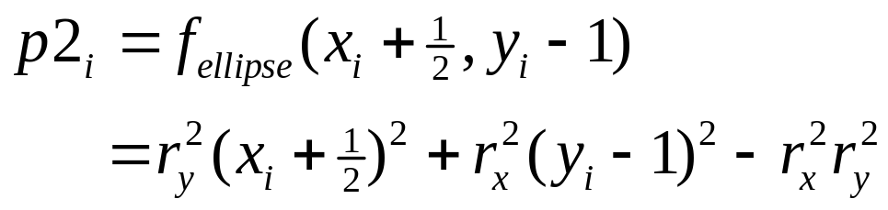
Region 2
Over region 2, step in the negative y direction and midpoint is taken between horizontal pixels at each step.
y_{i} | ■
y_{i}-1
 | x_{i} | x_{i}+1 | x_{i}+2
Midpoint
Decision parameter:
If p2_{i} > 0 the midpoint is outside the ellipse ⇒ x_{i} is closer
If p2i ≤ 0 the midpoint is inside the ellipse ⇒ x_{i} + 1 is closer

Slide 25
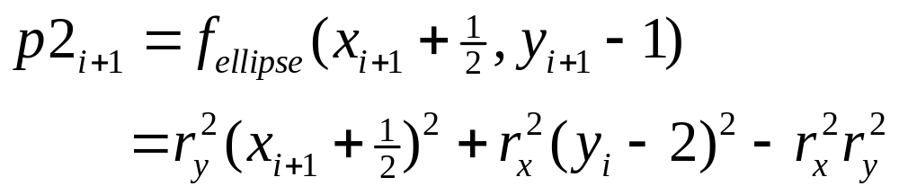
Decision Parameter (Region 2)
At the next position [y_{i+1} – 1 = y_{i} – 2]
OR
where x_{i+1} = x_{i}
or x_{i+1} = x_{i} + 1

Slide 26
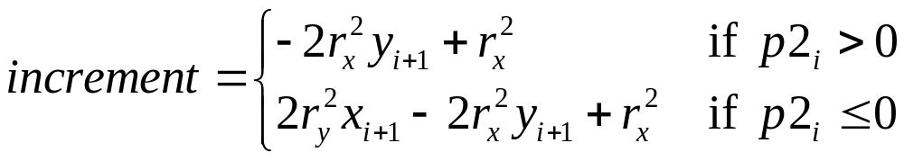
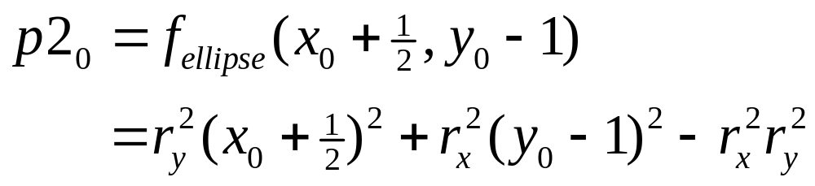
Decision Parameter (Region 2)
Decision parameters are incremented by:
At initial position (x₀, y₀) is taken at the last position selected in region 1

Slide 27
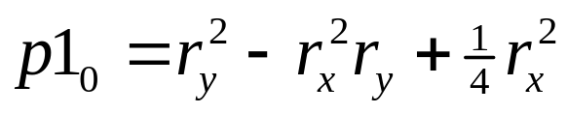
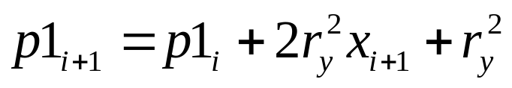
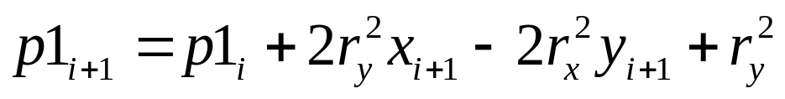
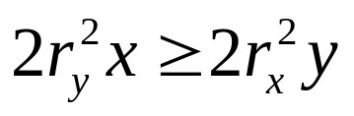
Midpoint Ellipse Algorithm
Input r_{x}, r_{y}, and ellipse center (x_{c}, y_{c}), and obtain the first point on an ellipse centered on the origin as
(x₀, y₀) = (0, r_{y})
Calculate the initial parameter in region 1 as
At each x_{i} position, starting at i = 0, if p1_{i} < 0, the next point along the ellipse centered on (0, 0) is (x_{i} + 1, y_{i}) and
otherwise, the next point is (x_{i} + 1, y_{i} – 1) and
and continue until

Slide 28
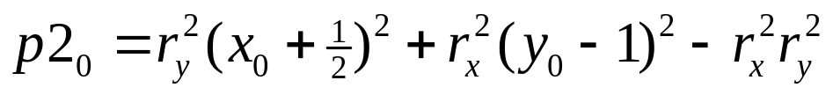
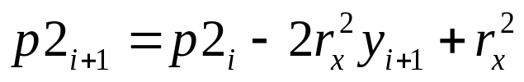
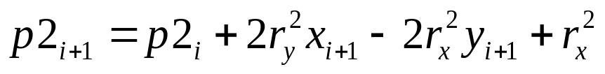
Midpoint Ellipse Algorithm
(x₀, y₀) is the last position calculated in region 1. Calculate the initial parameter in region 2 as
At each y_{i} position, starting at i = 0, if p2_{i} > 0, the next point along the ellipse centered on (0, 0) is (x_{i}, y_{i} – 1) and
otherwise, the next point is (x_{i} + 1, y_{i} – 1) and
Use the same incremental calculations as in region 1. Continue until y = 0.
For both regions determine symmetry points in the other three quadrants.
Move each calculated pixel position (x, y) onto the elliptical path centered on (x_{c}, y_{c}) and plot the coordinate values
x = x + x_{c} , y = y + y_{c}

Slide 29
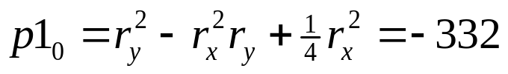
Example
r_{x} = 8 , r_{y} = 6
2r_{y}²x = 0 (with increment 2r_{y}² = 72)
2r_{x}²y = 2r_{x}²r_{y} (with increment -2r_{x}² = -128)
Region 1
(x₀, y₀) = (0, 6)
i | p_{i} | x_{i+1}, y_{i+1} | 2r_{y}²x_{i+1} | 2r_{x}²y_{i+1}
0 | -332 | (1, 6) | 72 | 768
1 | -224 | (2, 6) | 144 | 768
2 | -44 | (3, 6) | 216 | 768
3 | 208 | (4, 5) | 288 | 640
4 | -108 | (5, 5) | 360 | 640
5 | 288 | (6, 4) | 432 | 512
6 | 244 | (7, 3) | 504 | 384
Move out of region 1 since
2r_{y}²x > 2r_{x}²y

Slide 30

Example
Region 2
(x₀, y₀) = (7, 3) (Last position in region 1)
i | p_{i} | x_{i+1}, y_{i+1} | 2r_{y}²x_{i+1} | 2r_{x}²y_{i+1}
0 | -151 | (8, 2) | 576 | 256
1 | 233 | (8, 1) | 576 | 128
2 | 745 | (8, 0) | - | -
Stop at y = 0
6 | ■ | ■ | ■ | ■
5 |  |  |  |  | ■ | ■
4 |  |  |  |  |  |  | ■
3 |  |  |  |  |  |  |  | ■
2 |  |  |  |  |  |  |  |  | ■
1 |  |  |  |  |  |  |  |  | ■
0 |  |  |  |  |  |  |  |  | ■
 | 0 | 1 | 2 | 3 | 4 | 5 | 6 | 7 | 8

Slide 31
Exercises
Draw the ellipse with r_{x} = 6, r_{y} = 8.
Draw the ellipse with r_{x} = 10, r_{y} = 14.
Draw the ellipse with r_{x} = 14, r_{y} = 10 and center at (15, 10).

Slide 32
Midpoint Ellipse Function
void ellipse(int Rx, int Ry)
{
int Rx2 = Rx * Rx, Ry2 = Ry * Ry;
int twoRx2 = 2 * Rx2, twoRy2 = Ry2 * Ry2;
int p, x = 0, y = Ry;
int px = 0, py = twoRx2 * y;
ellisePlotPoints(xcenter, ycenter, x, y);
// Region 1
p = round(Ry2 – (Rx2 * Ry) + (0.25 * Rx2));
while (px < py) {
x++;
px += twoRy2;
if (p < 0) p += Ry2 + px;
else {
y--;
py -= twoRx2;
p += Ry2 + px – py;
}
ellisePlotPoints(xcenter, ycenter, x, y);
}
// Region 2
p = round(Ry2 * (x+0.5) * (x+0.5) + Rx2 * (y-1)*(y-1) – Rx2 * Ry2;
while (y > 0) {
y--;
py -= twoRx2;
if (p > 0) p += Rx2 – py;
else {
x++;
px += twoRy2;
p += Rx2 – py + px;
}
ellisePlotPoints(xcenter, ycenter, x, y);
}
}

